Slide 1

Linux Camera Tool
Leopard Imaging Inc
4/16/2019
Danyu

Slide 2
Functionality:
Video streaming for different type of USB3 cameras (YUV422, RAW10, RAW12) including debaying for RAW cameras
Gain and exposure control(ae enable, disable) (FIXME: experience split screen when updating values)
Software powered auto white balance
Software powered auto brightness and contrast (auto enhance ax+b)
Register read/write (both for sensor only or generic i2c slave)
Image capture (current resolution’s bmp, raw images)
Software powered gamma correction
Triggering mode demo (same as windows camera tool)
Software powered black level correction
Resolution updates from command line arguments
Frame rate updates from command line arguments
Allocate buffer updates from command line arguments(FIXME: nbufs > 1 will experience split screen)
TODO:
a. make video streaming faster -> use opencl/cuda to accelerate opencv etc
b. test cross platform performance -> try it on TX2, enable cuda etc
c. bug fixes of course

Slide 3
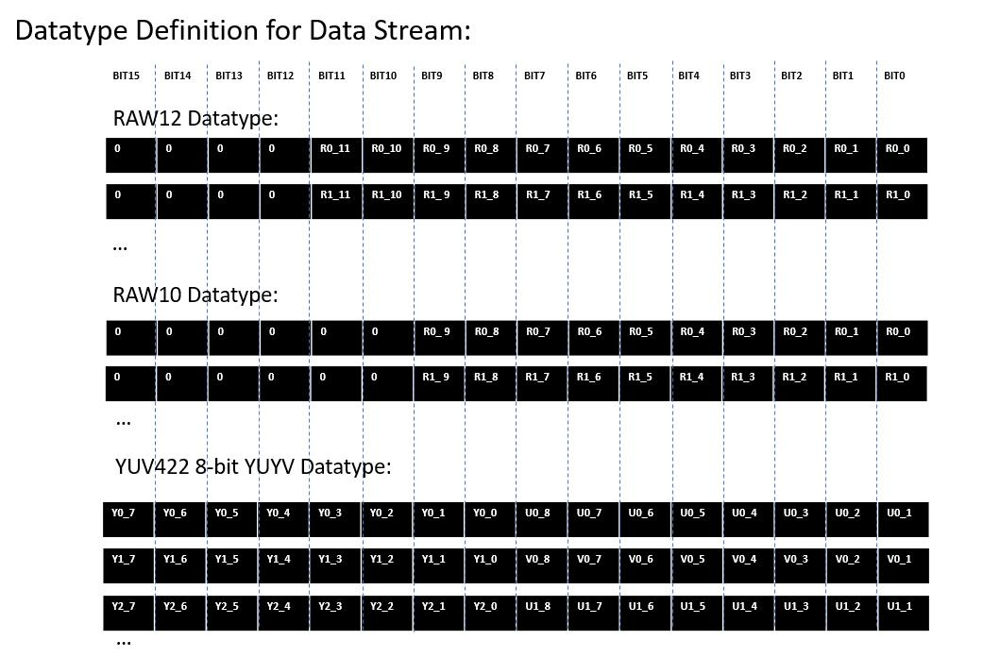

Slide 4
Code Directory Structure
folders:
doc - something like this file will be at
includes - common libraries, macros, data structures (shortcuts.h)
pic - picture screenshots for README.md
src - project source file (cpp&h)
test - main.cpp ui_control.cpp ui_control.h
files:
CMakeLists.txt - cmake project compilation files
README.md - readme files on installation, compilation and running this software
leopard_cam - the only executable for this linux camera tool
Makefile - makefile for building this software(alternative for CMakeLists.txt)
src/cam_property* - frame rate, gain, exposure, ae, ptz control
src/extend_cam_ctrl* - main backend code: gamma correction, awb, captures etc
src/uvc_extension_unit_ctrl* - all the uvc extension unit controls functionalities
src/v4l2_dev* - use udev for assigning right /dev/video#

Slide 5
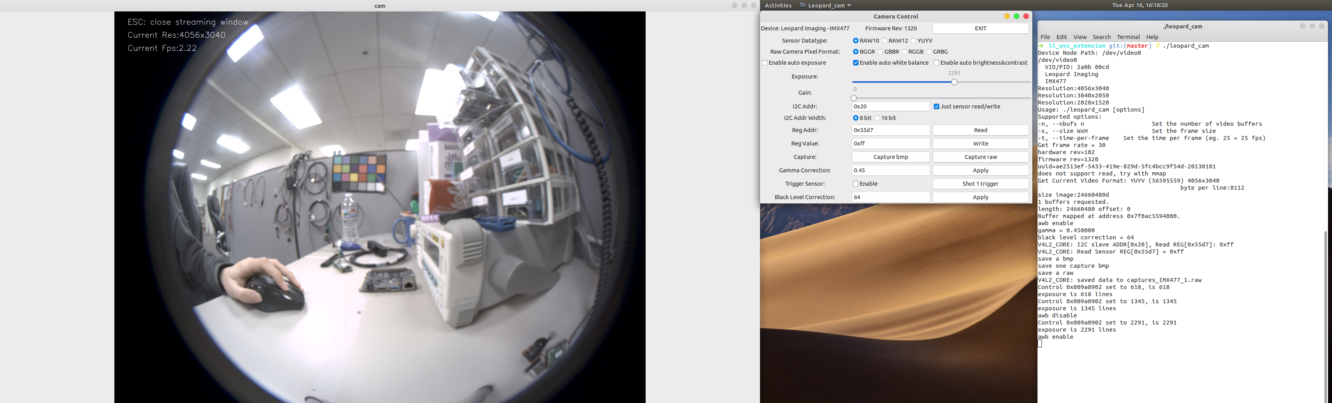
Functionality Demo 1:
Tested on IMX477 RGGB RAW10 Cam
Windows are divided into three:
camera display window, camera control window, terminal

Slide 6
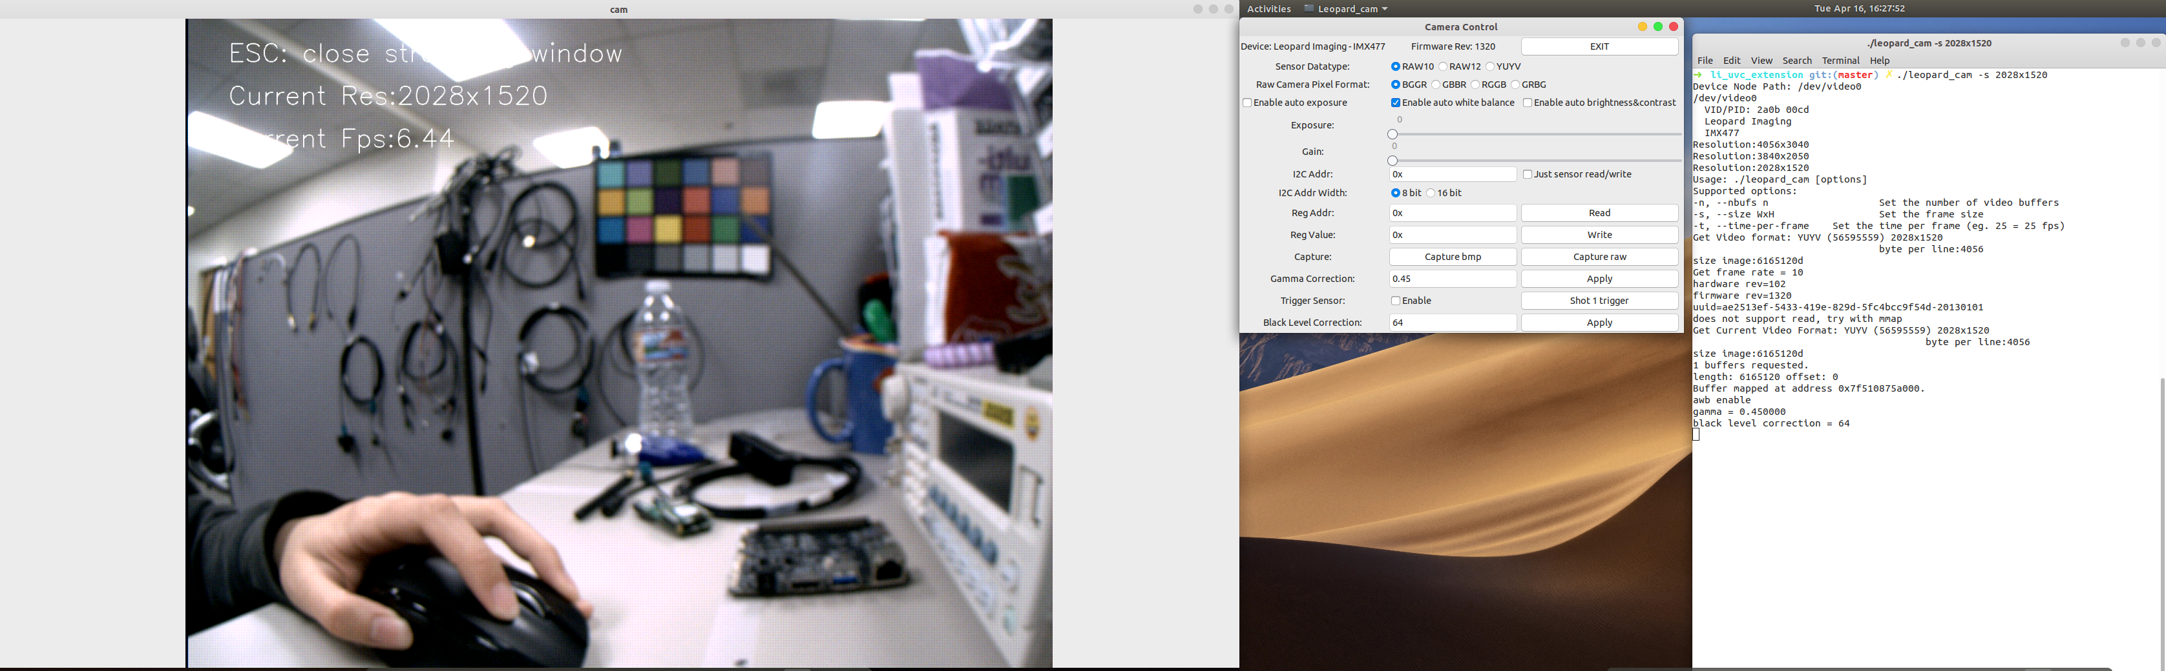
Functionality Demo 2:
Tested on IMX477 RGGB RAW10 Cam
To change resolution -> do a ./leopard_cam –s widthxheighth like so

Slide 7
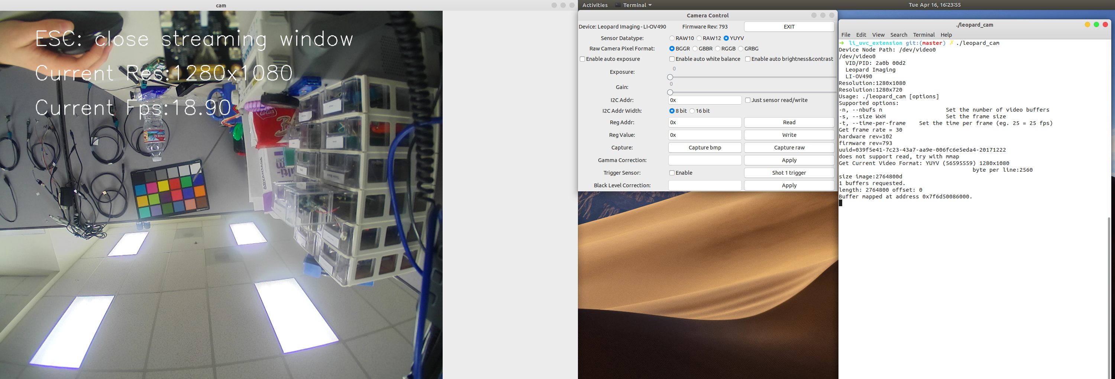
Functionality Demo 3:
Tested on OV10640-OV490-YUV Cam

Slide 8
References:
http://git.ideasonboard.org/?p=yavta.git;a=summary (yavta)
https://sourceforge.net/p/guvcview/git-master/ci/master/tree/ (guvcview)
https://git.linuxtv.org/v4l-utils.git (v4l-utils)
https://stackoverflow.com/questions/24341114/simple-illumination-correction-in-images-opencv-c (contrast limited adaptive histogram equalization algorithm)
https://gist.github.com/tomykaira/94472e9f4921ec2cf582 (auto white balance)
http://www.signal11.us/oss/udev/ (udev)

